Slide 1
Crassphage
Biophysical Sciences BRI 2018 - Microbial ‘Omics Workshop

Slide 2
Purpose of this talk
Get familiar with crassphage.
See an example of cool things that were discovered using (meta)genomics only.
Get familiar with the analysis plan for the workshop.

Slide 3
The short story
The first discovery of crassphage was published in 2014
It was identified in gut metagenomes
Found to be extremely prevalent in human gut
The host is still unknown, but predicted to belong to the phylum Bacteroidetes, and most likely include members of the genus Bacteroides.
In January 2018 a paper showed that crassphage is a member of a previously unknown family of phages named “crass-like phages”
In June 2018 a pre-print was published reporting the isolation of a ΦCrAss001, a crass-like phage, and identification of a Bacteroides intestinalis host.

Slide 5
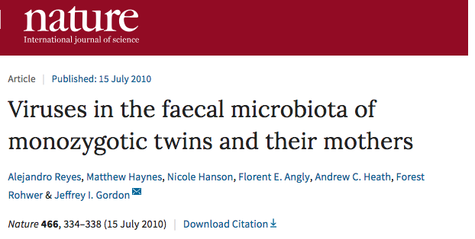
Identification of crassphage
Used previously published viromes
Cross-assembly
Predicted Bacteroides host using multiple approaches – including co-occurrence.

Slide 6
Figure 1: Schematic representation of the circular crAssphage genome.

Slide 7
Predicting host from Bacteroidetes phylum
Figure 2: CRISPR spacers similar to regions of the crAssphage genome.
Figure 3: Phage–host prediction based on co-occurrence across metagenomes.

Slide 8
Showing the ubiquity of crassphage
They used short read mapping to asses occurrence of crassphage and other phages in metagenomes.
Showed genome stability in gut metagenomes
Identified hypervariable regions within the crassphage genome
Figure 5: Normalized coverage plot of the crAssphage genome in 940 public metagenomes.
Figure 4: Abundance ubiquity plot of phage genomes in public metagenomes.

Slide 9
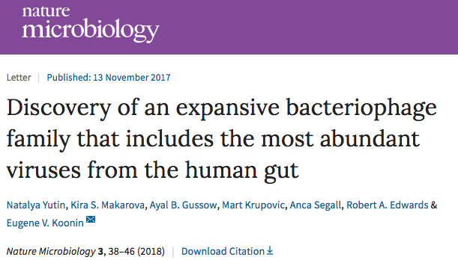

Slide 10
Fig. 1: Architecture and evolution of the capsid gene module of the crAss-like phage family.

Slide 11
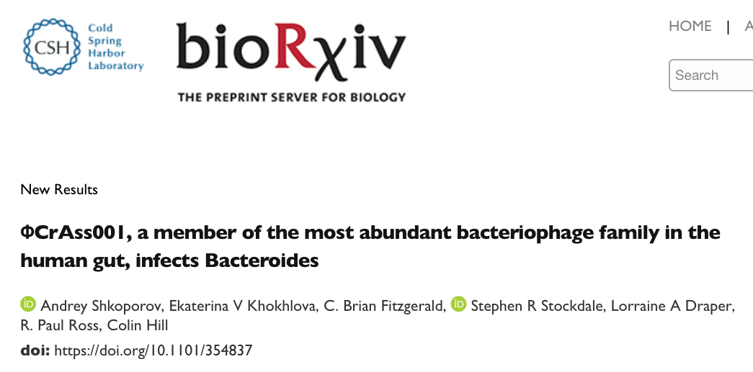

Slide 12
Isolation of crass-like phage and identification of host
Verifies a Bacteroides host for crass-like phages
But Bacteroides intestinalis is a low abundance member of the human gut (in contrast to other members of the genus Bacteroides, which are much more abundant), and hence it is not likely to be a dominant host for crassphage.
Still, this is a big deal! (says me)

Slide 13
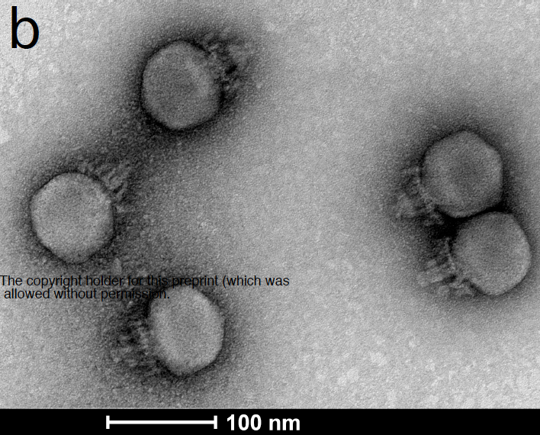
Figure 2. Morphology, growth and adsorption of φcrAss001.

Slide 14
Crassphage - summary
The most abundant phage in the human gut – only discovered in 2014, and thanks to metagenomics!
Led to a discovery of a large, previously unrecognized family of diverse phages.
First isolation of a member of the family four years later verifies predictions that were purely based on computational genomics:
Host membership
morphology

Slide 15
What we will do
Explore the global distribution of crassphage in four countries: USA, China, Fiji, and Tanzania.
We will try to predict the host for crassphage (i.e. create a figure similar to figure 3 of the original paper).

